Slide 1




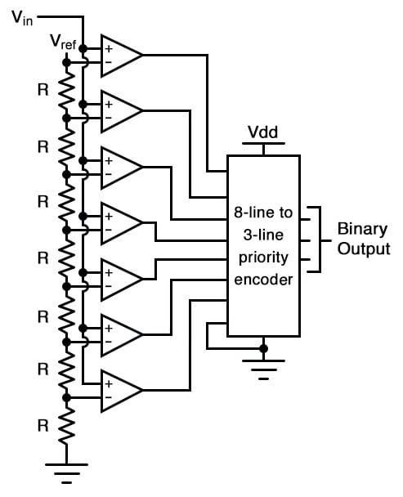
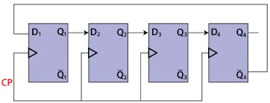

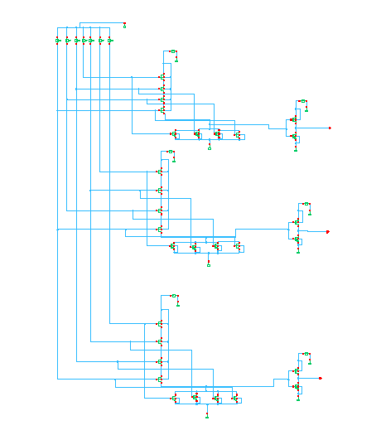
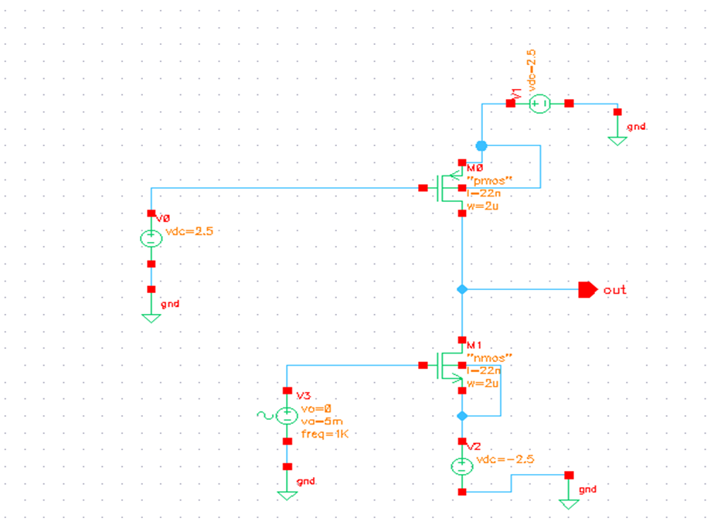
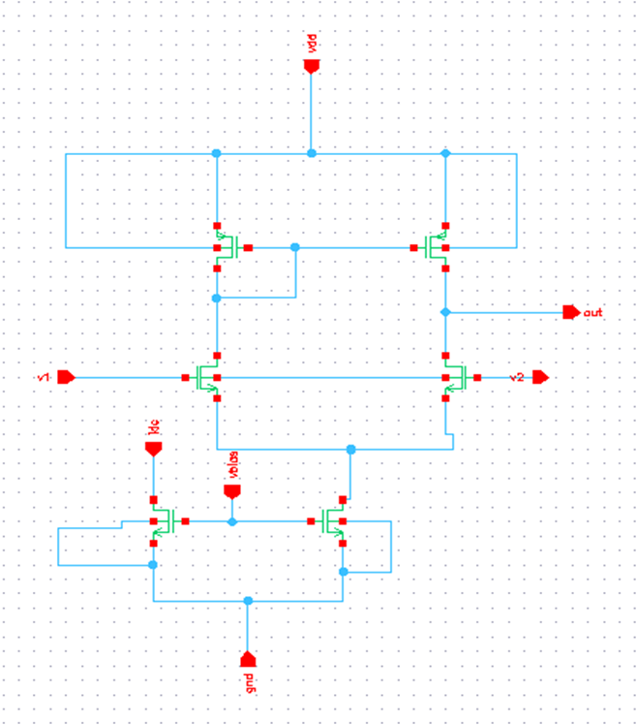
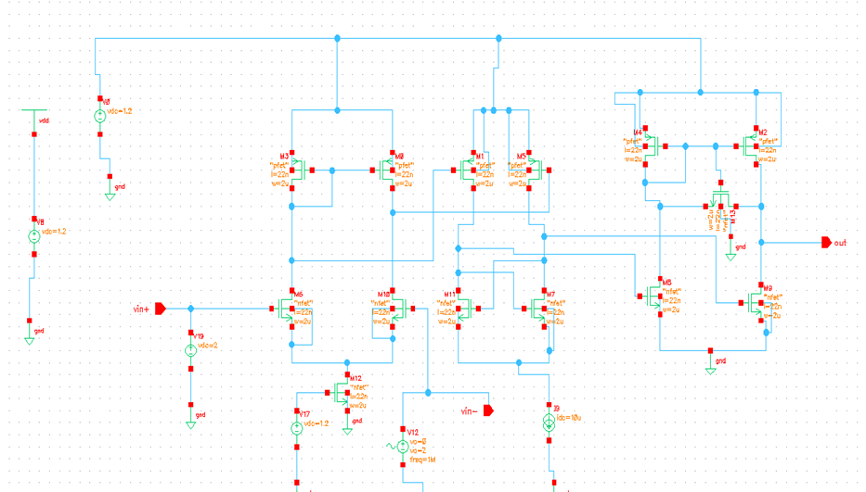
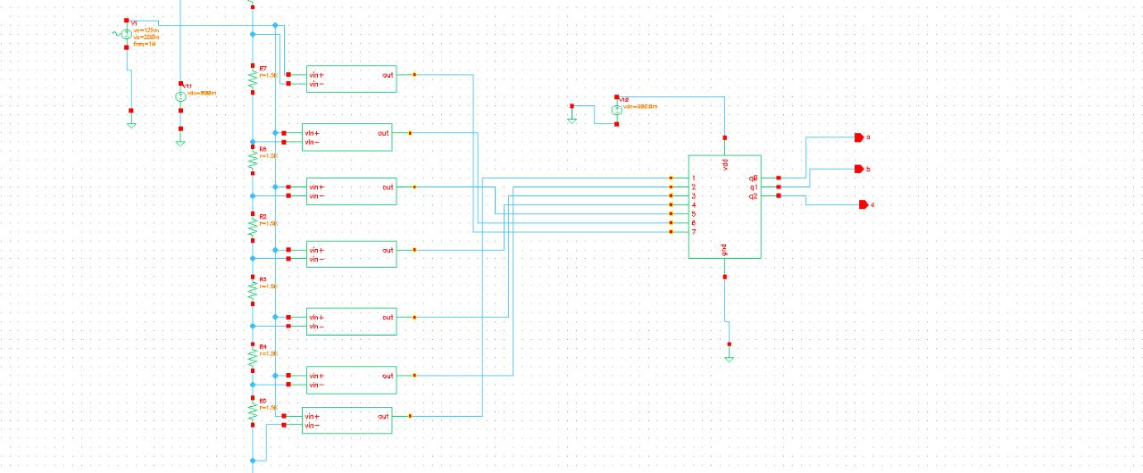
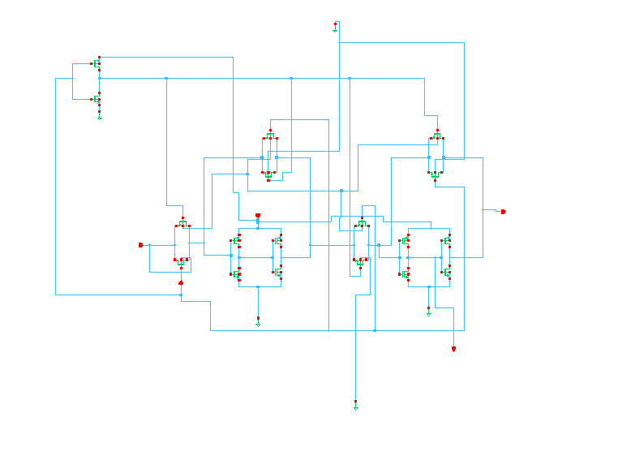
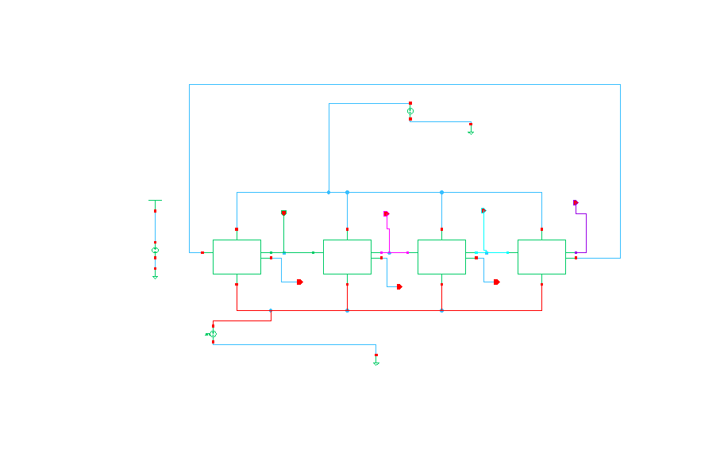
Dayananda Sagar College of Engineering, Bangalore, Karnataka
Department of Electronics and Communication Engineering
Project Open Day Presentation 2023
Design of FinFET Based Combinational and Sequential Circuits
INTRODUCTION
BLOCK DIAGRAMS
TOOL USED
The processor needs to have high performance and more speed. Scaling increases the packing density. Scaling of transistors demands low voltage supply, high packing density and reduced threshold voltage they exponentially increase the leakage power in the standby mode of all circuits. Scaling CMOS further into nanometer regime results in short channels effects. To reduce these short channel effects and improve the leakage power many methods were presented. Some of them are strained silicon, silicon-on-insulator, FinFET and MEMS. Among them, FinFET is effective method.
FinFET is a field effect transistor in which channel is above the substrate and the gate is wrapped around the channel, which leads to more control over the carriers.
ADC (Analog to Digital converter) convert real world analog signals into digital signal +to efficiently extract information from the signals.
Johnson Counter is also called as Twisted Ring Counter.
Johnson counter circuit diagram
The software tool used to implement the circuit is Cadence Virtuoso of 22nm technology.
Cadence virtuoso is an Analog design environment which help designer fully analyze, and verify the design.
Flash ADC circuit Diagram
IMPLEMENTATION
Flash ADC is implemented by design the circuits like R2R ladder, Comparator i.e. Op-Amp (Common source Amplifier and Differential Amplifier) and Priority Encoder. Johnson Ring counter is implemented by designing D-flipflop. These circuits are simulated and implemented for 22 nm technology in cadence virtuoso, in transistor level using PMOS and NMOS for CMOS design and PFET and NFET for FinFET design.
APPLICATION
Flash ADC applications:
Satellite Communication, RADAR processing etc.
The applications of Johnson counter are :
Frequency Division, Error Detection
SCHEMATIC DIAGRAMS
REFERENCES
Mr. Tilak Kumar L, Chandan A, Chethankumar K M, Dommeti Venkata Sai Krishna Vasanth, Hemant, “Power Efficient 4 Bit Flash ADC Using Cadence Tool”, International Research Journal of Engineering and Technology (IRJET), Volume: 09,(Issue: 07 e-ISSN: 2395-0056) p-ISSN: 2395-0072, 2022
Nirali Hemant Patel “Power Efficient 4-bit Flash ADC using Cadence Virtuoso” International Journal of Engineering Research & Technology (IJERT) ISSN: 2278-0181 Vol. 10 Issue 03, 2019
Xiaoyu Wang and Yukang Feng “Xiaoyu Wang and Yukang Feng” arXiv:1806.01443v1 [eess.SP]
PROBLEM STATEMENT
Priority Encoder(8:3) Common Source Amplifier Differential Amplifier
Scaling of transistors leads to reduction in size of IC (Integrated Circuit), also results in short channel effects if the scaling is done beyond nanometer.
OBJECTIVE
To design and performance evaluation of combinational logic circuit like 3bit Flash ADC and sequential logic circuit 4bit Johnson Counter on FinFET using 22nm technology.
To design basic circuits like comparator using op amp, and priority encoder (8:3)for Flash ADC and D-flipflop for Johnson Counter.
Comparator 3-Bit Flash ADC D-flipflop
ACKNOWLEDGEMENTS
Project Members: Bhanu Prasad Nayak (1DS19EC708), Chinnappa Reddy Gari Indu (1DS19EC710), T Sai Gautham (1DS19EC742), Pavan M (1DS20EC425).
Guide: Dr. Dinesha P, ECE Department
Johnson Counter

